Slide 1
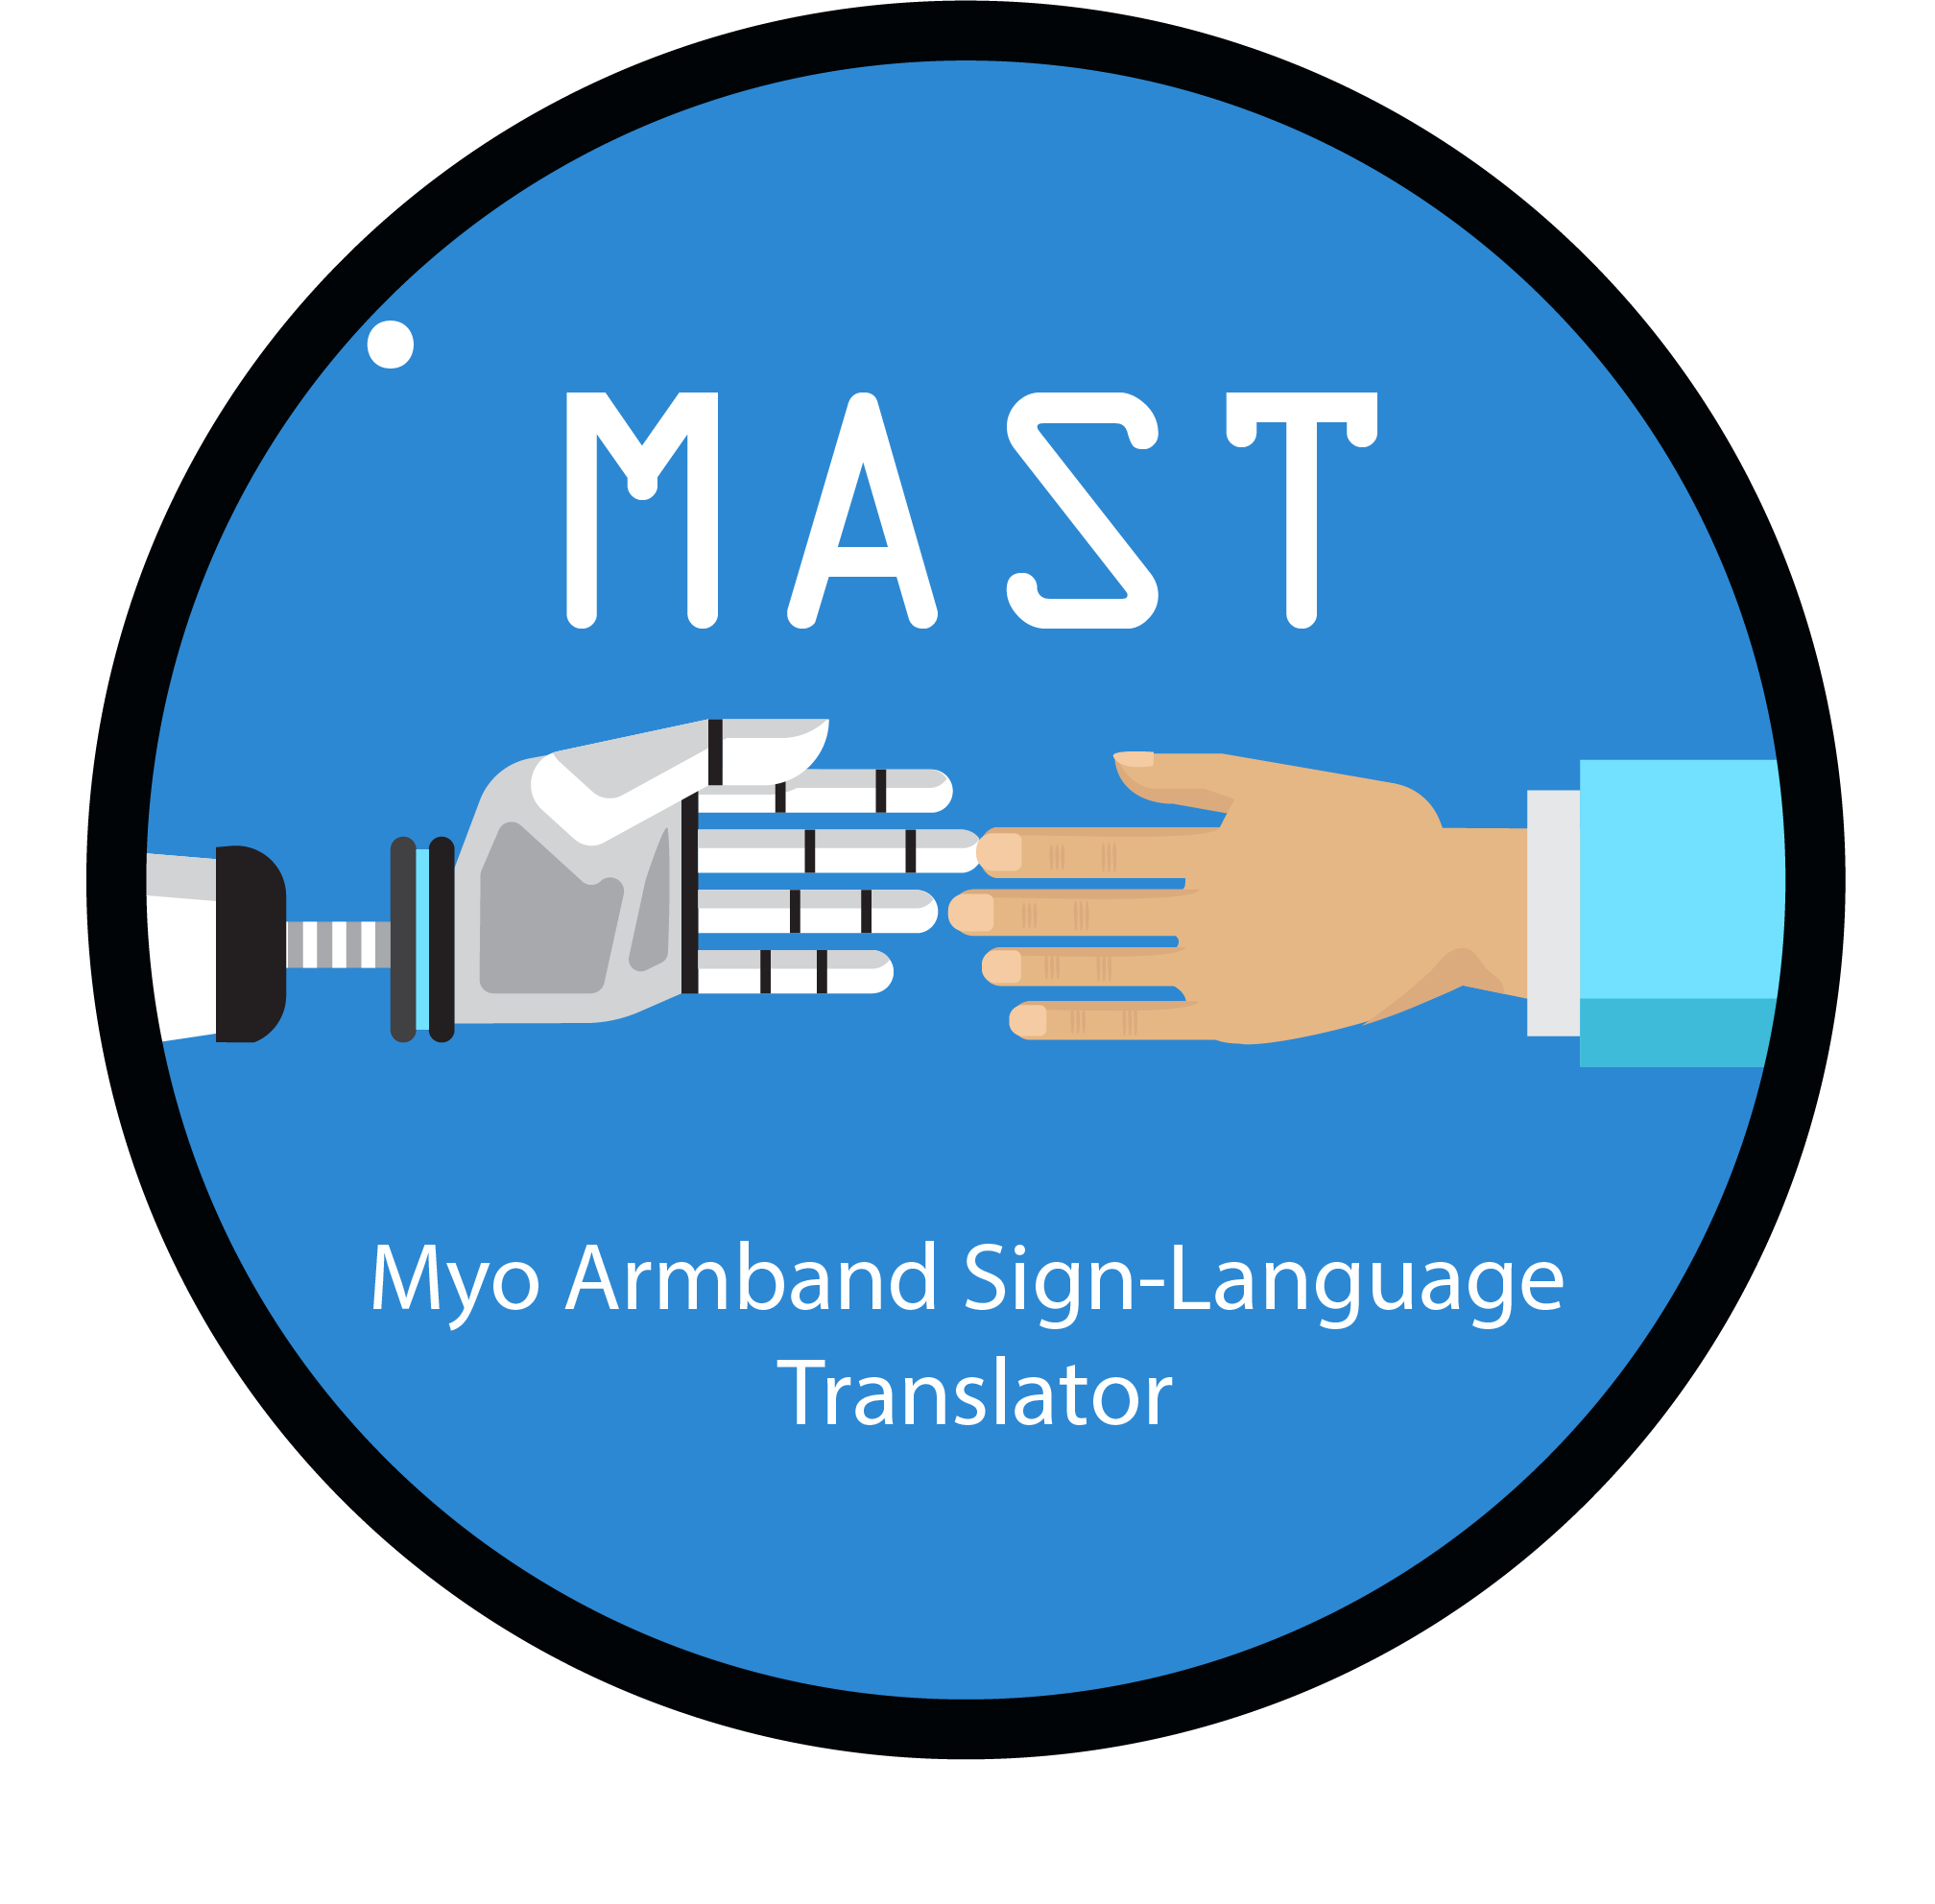
Capstone Design Project
Team1:
Muhammad Dahab
Software (Computer Science and Engineering)
2017314461
So Soonhyuk
Administration & Computer Science
2013313985
Go Seokhwan
System Engineering & Computer Science
2014313989

Slide 2
#01 Introduction #02 Related Work #03 Problem Formulation #04 Project Milestone

Slide 3
Introduction
#01

Slide 4
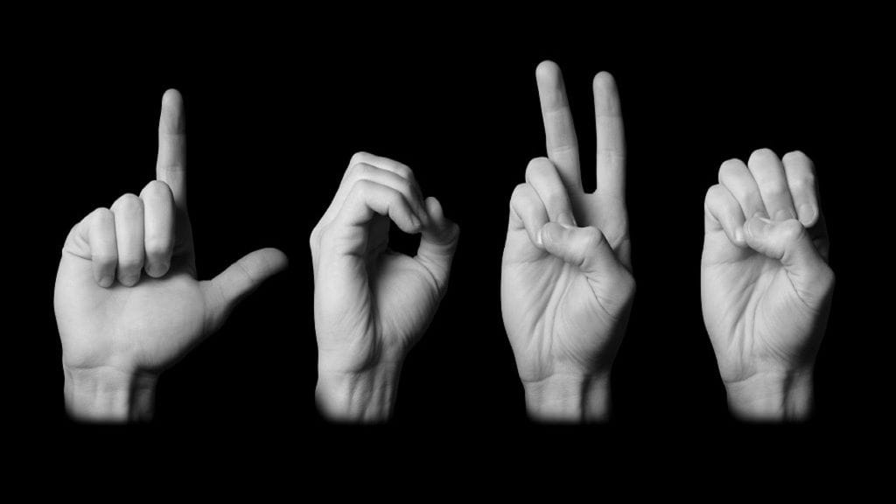
What is Sign Language?
A language that employs signs made with the hands and other movements, including facial expressions and postures of the body.
#01
Introduction

Slide 5
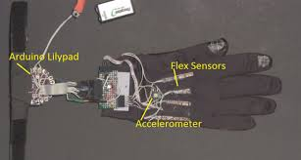
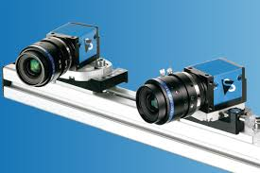
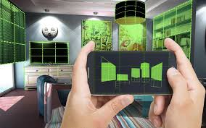
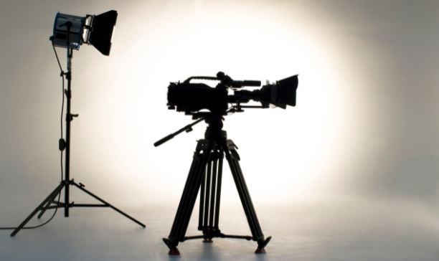
Trends of Sign Language Translation
SMT
CNN
1. Wired Glove/ Specialized Hardware
2. Stereo Cameras
CNN
CNN
3. Depth-Aware Camera
4. Single Camera
#01
Introduction

Slide 6
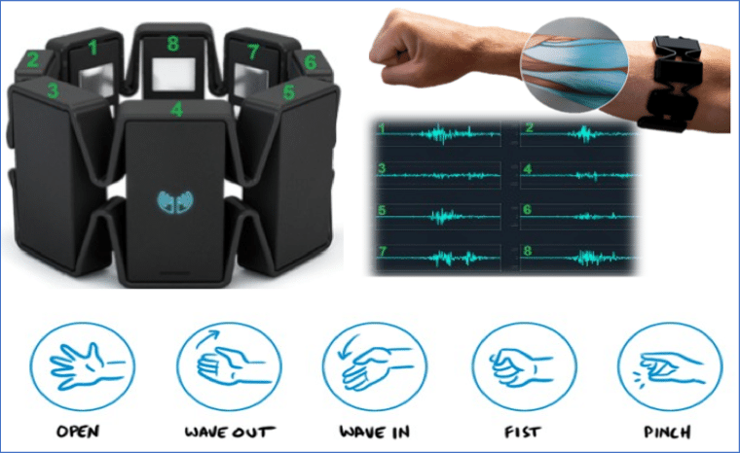
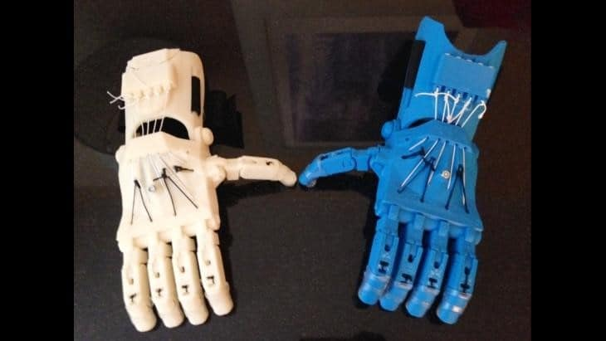
Key Idea
MYO sensor for tracking finger and hand movement through muscle contraction.
Artificial arms made by 3d printer to implement sign language.
#01
For efficient communication in hospital situation!
Introduction

Slide 7
Expected Contribution
Provide an efficient reliable translation system.
High accuracy compared to other introduced systems.
Resolve communication problems between patient and doctors without the need of interpreter.
Implement phrase translation rather than word or letter translation.
Demonstrate integration of soft electronic materials and circuitry in the medical field.
#01
Introduction

Slide 8
Related Work
#02

Slide 9
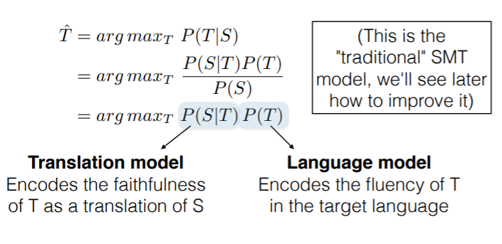
Techniques used in Sign Language Translation
1) Statistical Machine Translation(SMT):
Subfield of NLP.
Uses Specialized Hardware.
Needs huge amount of data.
Approximation of new untrained data based on probabilities.
S: Read data/values (untrained new data).
P(T): Probability of a specific trained data (T).
#02
Related Work

Slide 10
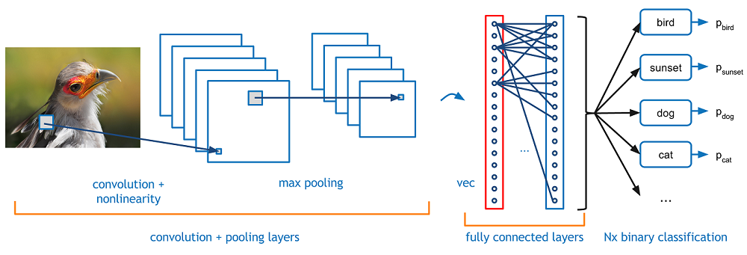
Techniques used in Sign Language Translation
2) Computer Vision:
Uses CNN.
No need for specialized hardware.
Approximation of new untrained data based on Neural Networks (Gradient Descent Method).
#02
Related Work

Slide 11
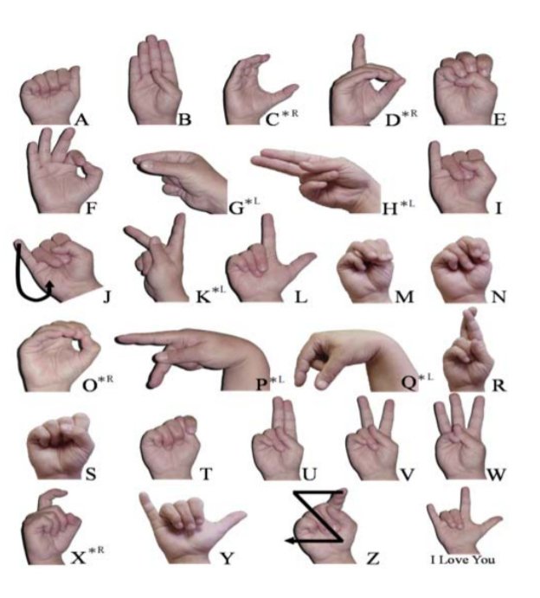
1st Paper: Sign Language Translator and Gesture Recognition
IEEE paper by the University of Gueplh.
Utilization of a specialized glove.
Technique used: SMT.
Accuracy of 96%.
Can only translate 20 gestures to 20 English letters.
#02
Related Work

Slide 12
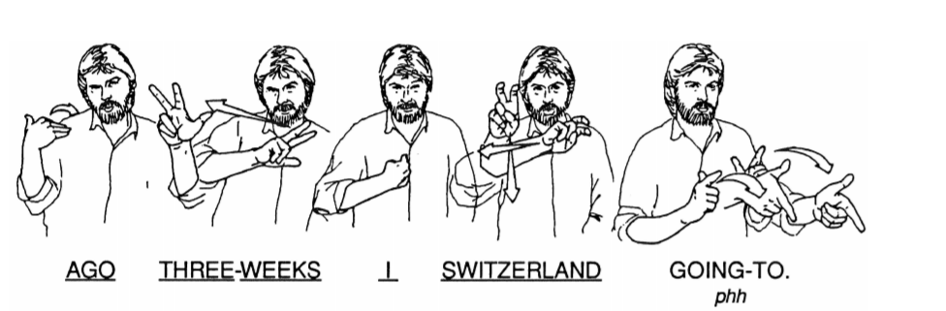
2nd Paper: Statistical Sign Language Translation
A very similar approach to the previous paper.
Improvement: translation of simple words to the German language.
#02
Related Work
Notes:
There are multiple sign langgauges

Slide 13
1st and 2nd Paper Cons
Can only translate 20 gestures to 20 English letters.
Translation of simple words to the German language.
Our approach:
More practical, useful and convenient for real-life scenarios (Medical Field).
#02
Related Work
Notes:
Their pros are cons -> practical?

Slide 14
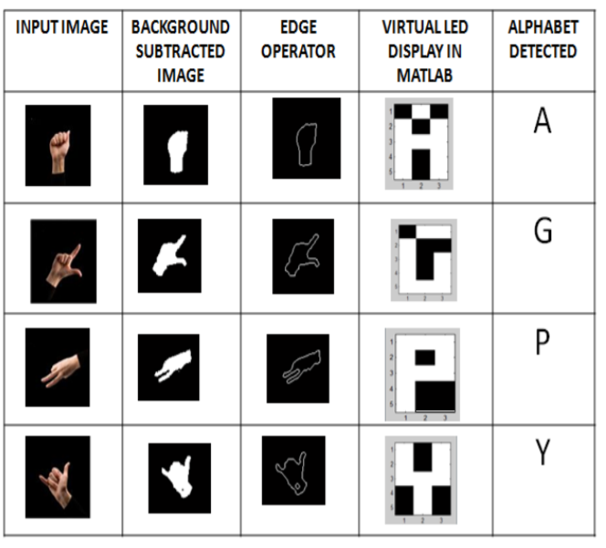
3rd Paper: Real-time Sign Language Translation based on Neural Network Architecture
IEEE paper by the University of Wisconsin.
Utilization of image processing .
Technique used: CNN.
Can only translate English letters.
Latency due to the time consumed in background subtraction process.
The need of certain picture conditions (lighting and clarity)
MAST is faster, more accurate and doesn’t require specific conditions.
#02
Related Work
Notes:
There are multiple sign langgauges we target general
with pre-trained custom gestures that will help any mute disabled person to easily use the gestures’ manual to convey their issue to the doctors without the need of a third part interpreter.

Slide 15
Problem Formulation
#03

Slide 16
Project’s Objective
Sign Language translation in diagnosis conversation.
From patient to doctor
From doctor to patient
#03
Problem Formulation
Notes:
Our goal is the implementation of sign language translator in the medical field. To be more specific, building model which is trained and a mobile or web environment that interacts between model and users. Next diagram shows how system works and its flow

Slide 17
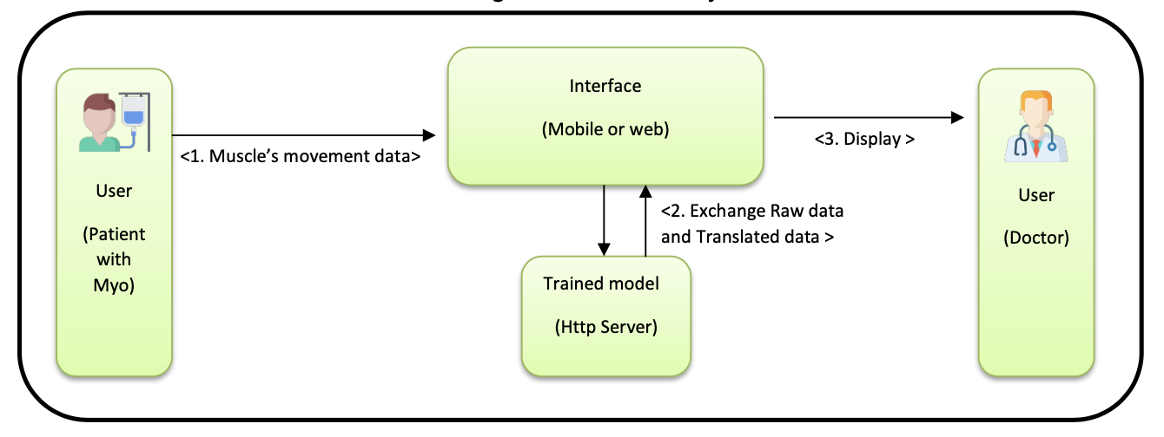
From patient to doctor
#03
Problem Formulation
Notes:
In case of a patient, Myo band attached to a patient sends raw myograph data to Interface (in number 1) . And number 2, the Interface exchanges raw data with translated data through REST API Server. Finally, Doctor will see an understandable language displayed in interface such as mobile app or web site.

Slide 18
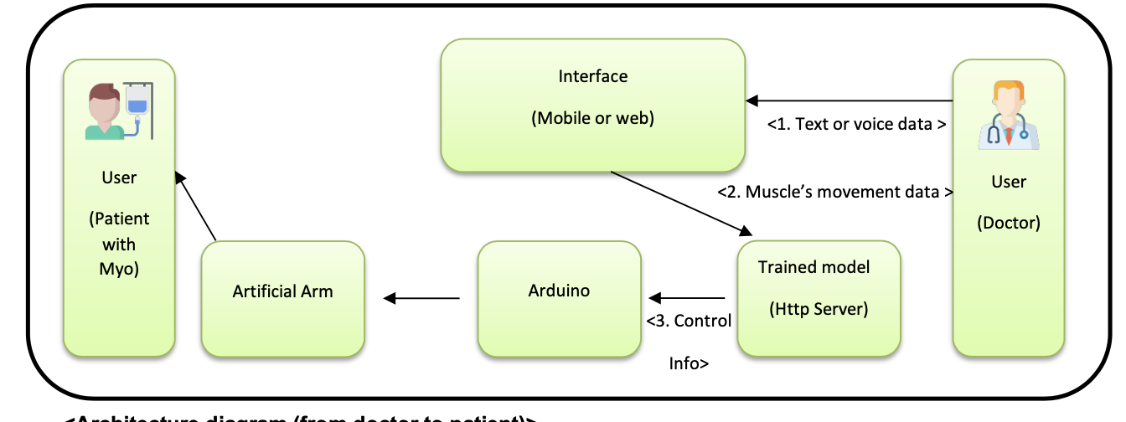
From doctor to patient
#03
Problem Formulation
Notes:
In case of a doctor, first, they can send a text or voice messages to the interface. Next, trained model request Arduino to control artificial arm according to muscle data which is received. Arduino will control motors to display sign language which go well with the input data from doctor.

Slide 19
Project’s constraints
Delayed time/ Latency
Patient’s discomfort and lack of knowledge.
Economic factors: use of monitors, 3d printed arms and MYO sensor.
#03
Problem Formulation
Notes:
However, there are constraints in this project. First, we need Real-time system because it is used in conversation. But, due to large-scale machine learning calculation, we predict from 3 to 8 seconds delay. Secondly, a patient must wear device MYO which makes a patient uncomfortable. Last, we need to unify display devices in hospital for visibility. It have to be taken in commercialization.

Slide 20
Project Milestone
#04

Slide 21
Expected Deadlines and Process
Phase | Expected Deadline
Conceptualization &Survey & Proposal | 4/6
Project Proposal Presentation & User Requirements Documentation | 4/13
Environmental Setting & Design 1 | 4/20
Design 2 | 4/27
Development (Frontend and Backend) | 5/31
System Integration & Deployment &Testing | 6/9
#04
Project Milestone

Slide 22
QnA

